Slide 1
SEPTEMBER FINANCIAL REPORT
Board Meeting September 26, 2024

Slide 2
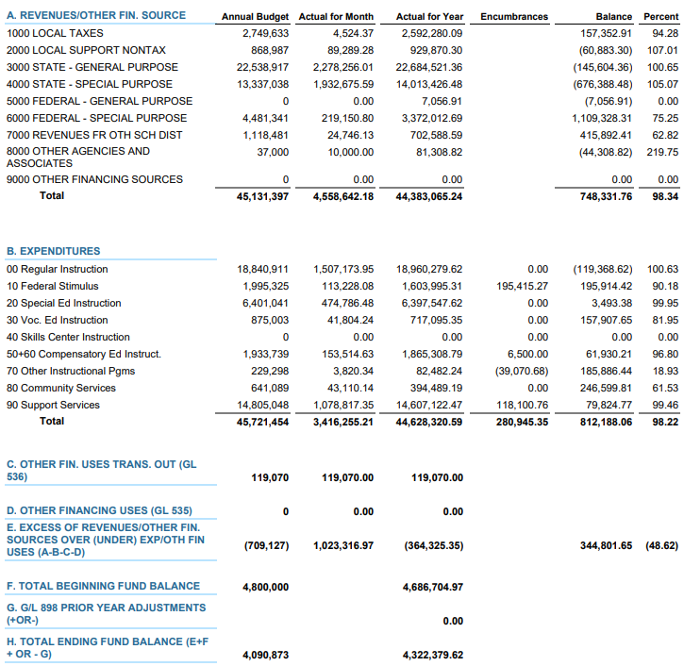
AUGUST 2024 BUDGET STATUS REPORT – GENERAL FUND

Slide 3
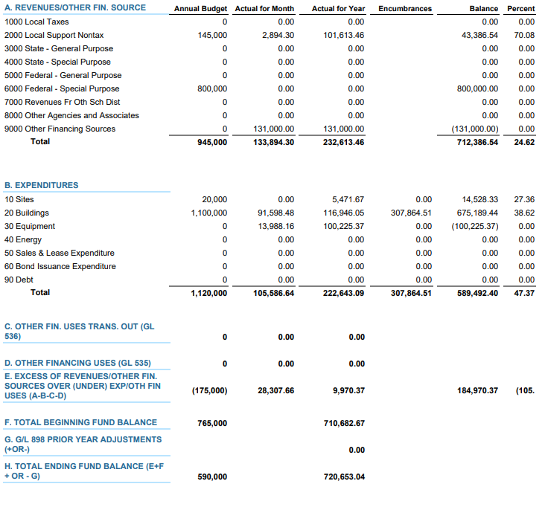
AUGUST 2024 BUDGET STATUS REPORT – CAPITAL PROJECTS FUND

Slide 4
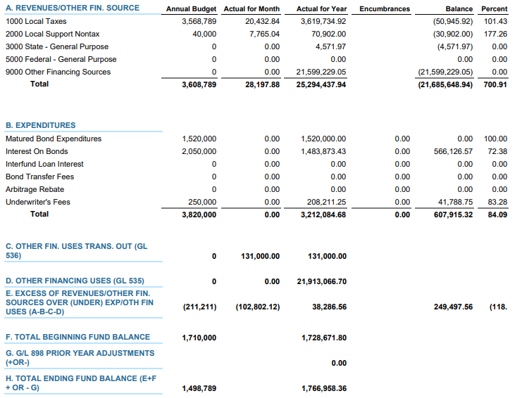
AUGUST 2024 BUDGET STATUS REPORT – DEBT SERVICE FUND

Slide 5
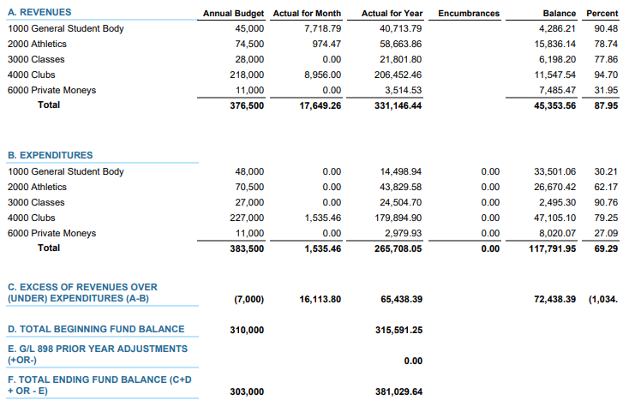
AUGUST 2024 BUDGET STATUS REPORT – ASB FUND

Slide 6
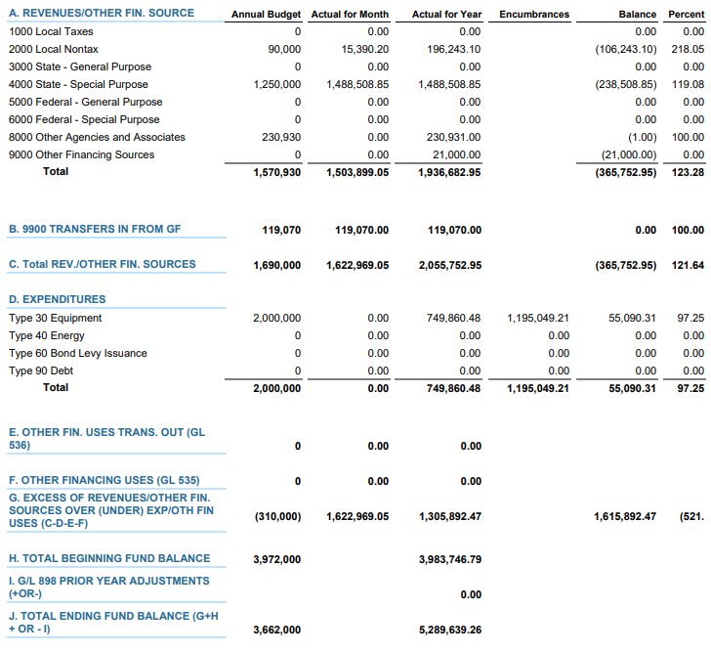
AUGUST 2024 BUDGET STATUS REPORT – TRANSPORTATION VEHICLE FUND

Slide 7
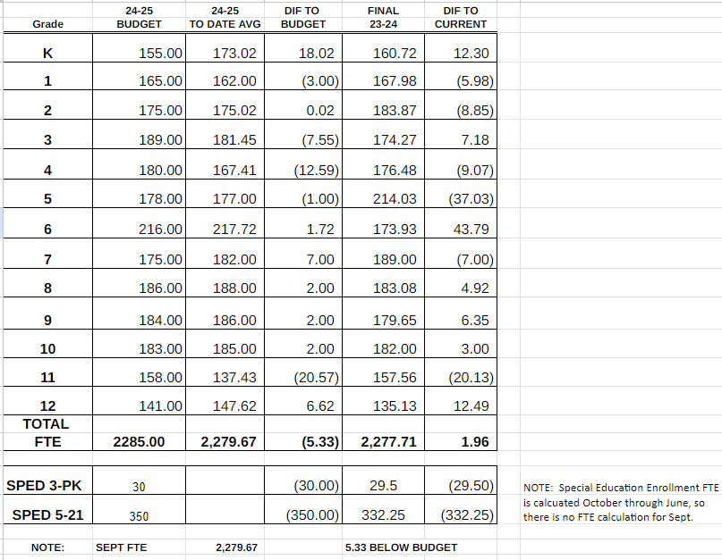
24-25 ENROLLMENT - FTE

Slide 8
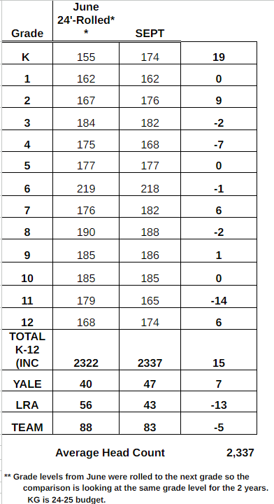
24-25 ENROLLMENT - HEADCOUNT

